Slide 1

Software Development Process Agile Development Methods
Translated from Indonesian to English - www.onlinedoctranslator.com
Team Teaching Software Engineering Courses Department of Information Technology
Malang State Polytechnic
Software Development Process (2)

Slide 2
Objective
To explain Agile Development Methods which is a software development methodology
Agile Development Methods software development processes and models

Slide 3
Agile Development Methods
The Agile Model is a software development process that developed in 1990. This methodology, known as agile development methods, prioritizes flexibility regarding changes that occur during development. Agile models include Rational Unified Process (1994), Scrum (1995), Crystal, Extreme Programming (1996), and Adaptive Software Development, Feature Driven Development, and Dynamic Systems Development Method (DSDM) (1995). And finally, in 2001, the Agile Modeling (AM) development process was formed.

Slide 4
Agile Modeling (AM) Development Process
Done in iteration or repetition. If a software development project is carried out using the agile method, then during the work period there will always be an iterative development process.

Slide 5
12 Principles of Agile Development Methods
The top priority is to satisfy clients by producing valuable software quickly and regularly
Ready for changing needs. Agile processes leverage change for the client's benefit
Produce software that works routinely, from a few weeks to several months, with an emphasis on short time periods
Business partners and software developers must work together throughout the project
The project development environment has a motivational atmosphere. Give them the environment and support they need, and trust them to get the job done well
The most efficient and effective method for exchanging information from and within a development team is by direct communication
Notes:
Explained in general terms each basic activity in software development. In detail and in depth, it will be discussed at subsequent meetings

Slide 6
Working software is the ultimate measure of a team's progress
Agile processes support continuous development with a consistent development pace
Attention to technical and design details will increase agility
Simplicity (maximizing the amount of work yet to be done) is very important
Self-organizing teams support good software architecture, requirements, and design
Periodically, the development team reflects on how to make development more effective, then adjusts the way they work.

Slide 7
Benefits of Agile development methods
High-value & working App system
Iterative, incremental, evolutionary
Cost control & value-driven development
High-quality production
Flexible & risk management
Collaboration
Self-organizing, self-managing teams

Slide 8
High-value & working App system
Software can be produced that has a high selling value, manufacturing costs can be reduced and the software can run well

Slide 9
Iterative, incremental, evolutionary
The team must work in a short time (usually 1-3 weeks) and also always add functionality to the software according to the client's needs

Slide 10
Cost control & value-driven development
Software development is tailored to user needs, the team can quickly respond to user needs so that the time and costs of creating software can be controlled

Slide 11
High-quality production
The cost of creating software can be reduced and the manufacturing process can be accelerated, but the quality of the software created must be maintained
By testing each software functionality after it has been created, Agile also accommodates this need

Slide 12
Flexible & risk management
If you use the manufacturing method that is usually used and if you want to change the functionality of the wireframe that has been created, it requires a complicated process
Starting from meetings with system analysts to change software systems, changes to product release plans to changes in production costs so that software functionality is easily changed and ultimately software failures can be minimized.

Slide 13
Collaboration
The development team is required to meet frequently to discuss project progress and feedback from clients which will later be added to the software, so that the team can collaborate optimally

Slide 14
Self-organizing, self-managing teams
Hire the best people, provide and support their needs and then let them work. That is the difference between agile and other HR. With agile, developers can manage themselves, while team managers are only tasked with collaborating software developers with clients. So a solid team is created

Slide 15
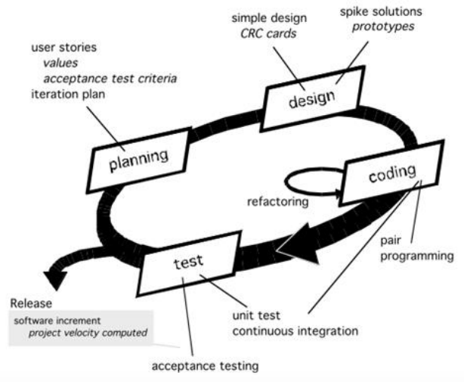
Agile XP Model (eXtreme Programming)
This model not only carries out the code and testing process, but also carries out the process of mapping the system architecture so that the coding and testing process can be carried out without disturbing the existing system. The ongoing system analysis process is carried out in order to better understand the system workflow

Slide 16
Stages - Agile Model
Planning
Planning is a methodical process designed to achieve specific goals and decision making to achieve desired results. Requirements needed at this stage of data collection techniques:
Analysis of system requirements
Identify actors
Identify use cases

Slide 17
Stages - Agile Model
Design
ADesign activities in application development aim to organize logical patterns in the system. A good design can reduce dependency between each process in a system. That way, if one feature on the system is damaged, it will not affect the system as a whole

Slide 18
Stages - ModelAgile
Coding
After the various unit tests have been built, the team then continues its activities with writing application coding. XP applies the pair programming concept where each task of a module is developed by 2 programmers

Slide 19
Testing
4. Testing
At this testing stage, the application is directly tested by the user or client and receives direct feedback regarding the application of the story described previously

Slide 20
Advantages of XP
Immediate feedback after receiving a response from the user
Collective ownership which does not depend on one person for work
Changes and additions to requirements can be responded to even though the development process is almost complete
A development process that includes one person from the user side as an on-site customer makes communication easier during the development process
A popular method because it is more relaxed and non-restrictive
Cheaper costs
Able to automate tests
Respond to every feedback by carrying out tests, unit tests or system integration and don't delay because costs will increase (money, energy, time)
Lots of new ideas and dare to try them, dare to rework and every time an error is found, it is immediately corrected

Slide 21
Lack
Developers must always be ready for change because change will always be accepted
Cannot create detailed code at the start (simplicity principle and also the recommendation to do what is needed that day)
XP has no formal documentation created during development. The only documentation is the initial documentation carried out by the user
Communication is always oral without formal documentation

Slide 22
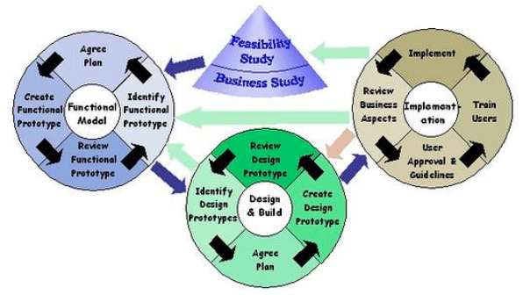
DSDM Agile Model (Dynamic Systems Development Method)
Dynamic System Development Methodprovideframework for building and maintaining systems in a limited time through the use of incremental prototyping in a conditioned environment

Slide 23
DSDM Agile Model (Dynamic Systems Development Method)
1. Feasibility Study
Is a high-level feasibility report that allows the project steering committee to decide on the future of the project, and further feasibility studies

Slide 24
DSDM Agile Model (Dynamic Systems Development Method)
2. Functional Model
Functional models consist of both working software prototypes and static models. This phase results in the processing of information obtained in business research

Slide 25
DSDM Agile Model (Dynamic Systems Development Method)
3. Design and Build Iteration
This phase perfects the functional prototype developed to meet functional requirements (Modules), namely:Identify, Plan, develop, validate functions

Slide 26
DSDM Agile Model (Dynamic Systems Development Method)
4. Implementation Phase
After various unitstestOnce built, the team then continues its activities with writing application coding. XP applies the pair programming concept where each task of a module is developed by 2 programmers

Slide 27
ExcessDSDM (Dynamic Systems Development Method)
This method will build software quickly, 80% of the project is delivered in 20% of the total time to deliver the complete project
Dynamic System Development Method can be combined with eXtremeProgrammingresulting in a combination of process models that follow the Dynamic System Development Method and practices that are in line with eXtremeProgramming

Slide 28
LackDSDM (Dynamic Systems Development Method)
Business Studies provides the basis for all subsequent product development
This phase looks at the affected business processes in detail and the information they require

Slide 29
Conclusion
Agile means being fast, light, free to move. So when creating software using agile development methods innovation and innovation are neededresponsibilitybetween the development team and the client so that the quality of the software produced is good and the agility of the team is balanced
The Agile Manifesto is the values ​​used to underlie the ongoing Agile Software Development
Agile Software Development, interacting with personnel is more important than processes and tools, working software is more important than complete documentation, collaboration with clients is more important than contract negotiations, and responsiveness to change is more important than following a plan

Slide 30
Agile Development Methods were developed because in traditional methodologies there are many things that make the development process unable to be successful according to user demands.
This methodology has been developed quite a lot, one of which is ExtremeProgramming(XP), Adaptive Software Development (ASD), Dynamic Systems Development Method (DSDM), Scrum Methodology, Crystal, Feature Driven Development (FDD), Agile Modeling (AM)

Slide 31
SCRUM
Translated from Indonesian to English - www.onlinedoctranslator.com
Scrum

Slide 32
Objective
Students are able to explain the concept of the Scrum framework which consists of
Roles
Events
Artifacts

Slide 33
Scrum in 100 words
Scrum is an Agile process that allows us to focus ondeliverywith the highest business value in the shortest time.
Scrum allows us to inspect software that is created quickly and repeatedly (every 2 weeks – once a month)
Personnel from the business side determine priorities. The team independently determines the best path todeliverthe features with the highest priority.
Every 2 weeks – 1 month, everyone can see the results of their work in the form of usable software, which can then be decided to be released or continued development in the next sprint.

Slide 34
Scrum Has Been Used By:
Microsoft
Yahoo
Google
Electronic Arts
IBM
Lockheed Martin
Phillips
Siemens
Nokia
Capital One
BBC
Intuit
Nielsen Media
First American Real Estate
BMC Software
IPswitch
John Deere
Lexis Nexis
Sabre
Salesforce.com
Time Warner
Turner Broadcasting
Oce

Slide 35
Scrum Has Been Used For:
Commercial software
In-house development
Contract project
Projectfixed-price
Financial applications
ISO 9001 certified application
Immersed system
24x7 system with 99.999%uptime
ProjectJoint Strike Fighter
Makingvideo games
FDA-approved, life-critical systems
Satellite control software
Website
Handheld software
Mobile phones
Network switching applications
ISV applications
Some of the big applications that we know

Slide 36
Characteristics
independent team,self-organized
Products are processed in a series of activities lasting 1-4 weeks called "Sprints".
System requirements are compiled as items in a list referred to as “Product Backlog”.
Deliberately made not too rigid, detailed and technical.
Using certain generative rules to create an "agile environment" in project completion.
Is one of the "agile processes"

Slide 37


Agile Manifesto
Individuals and interactions
over
Process and tools
Comprehensive documentation
Working software
over
Customer collaboration
over
Contract negotiation
Responding to change
over
Following a plan
Source: www.agilemanifesto.org

Slide 38





Scrum
24 hours
Sprints
2-4 weeks
Sprint goals
Return
Sprint backlog
Return
Return
Products that “can be used”
Gift wrapping
Coupon
Present
Cancel
Vouchers
Products
backlog

Slide 39
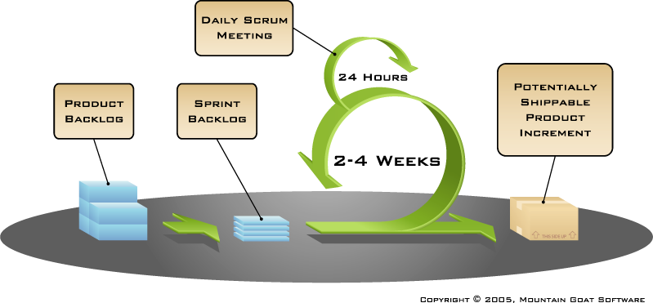
Scrum
Source:www.mountaingoatsoftware.com/scrum

Slide 40
Sprints
Progress on a Scrum project is carried out in “Sprints”.
Or known as "iteration" in the Extreme Programming method.
The general duration is 2-4 weeks or a maximum of 1 month.
Consistent duration will produce a good team work rhythm.
Software is designed, coded, and tested in each Sprint.

Slide 41

Sequential vs. Sequential overlapping development
Requirements
Design
Code
Test
Instead of working one by one until it's finished
...The Scrum Team does this in small increments but simultaneously.
Source: “The New New Product Development Game” by Takeuchi and Nonaka.Harvard Business Review,January 1986.

Slide 42


There should be no changes while the Sprint is running..
Change
The duration of the Sprint must be planned according to the team's ability to prevent changes from occurring within one Sprint.

Slide 43
Scrum Framework
Roles
Product owner
ScrumMaster
Team
Events
Sprint planning
Sprint review
Sprint retrospectives
Daily scrum meetings
Artifacts
Product backlog
Sprint backlog
Burndown charts

Slide 44
Scrum Framework
Roles
Roles
Product owner
ScrumMaster
Team
Product owner
ScrumMaster
Team Member
Ceremonies
Ceremonies
Sprint planning
Sprint review
Sprint retrospectives
Daily scrum meetings
Sprint planning
Sprint review
Sprint retrospectives
Daily scrum meetings
Artifacts
Artifacts
Product backlog
Sprint backlog
Burndown charts
Product backlog
Sprint backlog
Burndown charts

Slide 45

Product owner
Determine what features must be in the product being developed.
Deciding content and release time.
Responsible for product profits (ROI).
Determine feature priorities based on market conditions.
Reorganize features and their priorities at each iteration, as needed.
Accept and/or reject team work results.

Slide 46

The ScrumMaster
Play a “management” role in the project.
Responsible for upholding Scrum values ​​and practices.
Remove barriers/obstacles.
Ensure the team is fully functional and productive.
Ensure cooperation and closeness to allrolesand function within the team.
Protect the team from external interference.

Slide 47





Team Member
Generally consists of 5-9 people.
Cross-functional:
Programmer, QA Engineer, User, UI/UX Designer, etc.
All members must work full time.
Although sometimes there are exceptions (Example: database administrator)
Teams are independent,self-organizing
Ideally there is no position/title, but sometimes (very rarely) there can be.
Membership may not change while the Sprint is in progress.
Can be replaced when there is a break between two Sprints.

Slide 48
Scrum Framework
Roles
Roles
Roles
Product owner
ScrumMaster
Team
Product owner
ScrumMaster
Team
Product owner
ScrumMaster
Team Member
Ceremonies
Ceremonies
Events
Sprint planning
Sprint review
Sprint retrospectives
Daily scrum meetings
Sprint planning
Sprint review
Sprint retrospectives
Daily scrum meetings
Sprint planning
Sprint review
Sprint retrospectives
Daily scrum meetings
Artifacts
Artifacts
Artifacts
Product backlog
Sprint backlog
Burndown charts
Product backlog
Sprint backlog
Burndown charts
Product backlog
Sprint backlog
Burndown charts

Slide 49


Sprint Planning Meeting
Team capacity
Sprint prioritization
Product backlog
Analysis and evaluation of product backlog.
Determining sprint goals
Sprints
goals
Business conditions
Sprint planning
Deciding how to achieve the sprint goal (design)
Create a sprint backlog (tasks) of the items in the product backlog items (user stories / features)
Estimate sprint backlog in man hours.
Current product
Sprints
backlog
Technology

Slide 50

Sprint planning
The team selects items from the product backlog that they are confident they can complete within 1 Sprint.
Creating a Sprint Backlog:
Each existing task is identified and estimated how long it will take in hours (1-16 hours)
Done collaboratively, not alone by the Scrum Master.
The consideration used is "high level design" or "user story".
As someone who is going on holiday, I want to see photos of the available hotels.
Middle tier coding (8 hours)
Working on the user interface (4 hours)
Making test fixtures (4 hours)
Creating the main classes (6 hours)
Updating performance tests (4 hours)

Slide 51
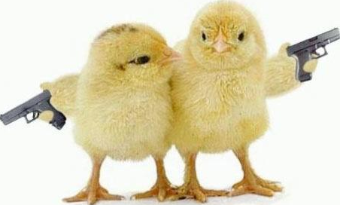
Event #1: Daily scrum
Characteristic:
Daily
A maximum of 15 minutes must be completed
Stand up (No, seriously. The one whose turn it is to speak cannot sit down)
Not to “solve problems”
Everyone is invited.
But only those who are allowed to speak are: Team Members, ScrumMaster, and Product Owner
Helps to avoid prolonged meetings and going here and there.

Slide 52

In Daily Scrums, everyone shares:
1
What were you doing yesterday?
2
What are you going to do today?
3
Is it availableblockers?
Here all team members must be honest. It's not just an image if it looks like you were working yesterday even though you were just doing ityoutube-an.
Each person is committed to all his colleagues.

Slide 53
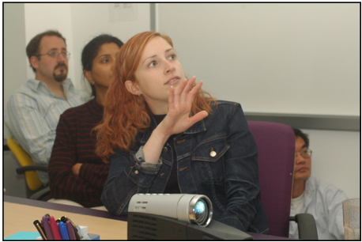
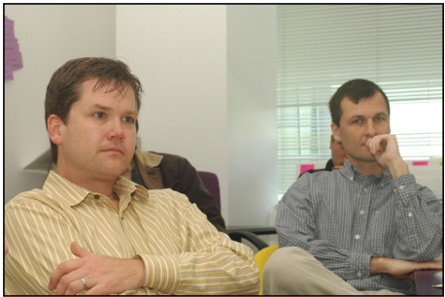
Event #2: Sprint Review
The team presents what has been achieved at the end of one recently completed Sprint.
Generally in the form of demonstrating new features of the application being created or explaining the architecture in the application.
Informal
Maximum 4 hours must be completed.
Don't use PPT.
All teams participate.
Invite all related people and/or parties.

Slide 54
Event #4: Sprint retrospective
Periodically review what is working and what is not working well.
Maximum 3 hours if the sprint is 1 month, or shorter.
Done every time a Sprint is finished.
Everyone takes part:
ScrumMaster
Product owner
Team Member
It could be our clients and others who need/are interested.

Slide 55

In the Sprint Retrospective, we discuss: Start/Stop/Continue
The whole team gets together and discusses what they want:
Starting to do it
Stop doing
Not only technically related, but it could be anything. As long as everyone agrees. Example: “Mom, we need snacks”
Keep doing it

Slide 56
Scrum Framework
Roles
Roles
Roles
Roles
Product owner
ScrumMaster
Team
Product owner
ScrumMaster
Team
Product owner
ScrumMaster
Team
Product owner
ScrumMaster
Team Member
Ceremonies
Ceremonies
Events
Events
Sprint planning
Sprint review
Sprint retrospectives
Daily scrum meetings
Sprint planning
Sprint review
Sprint retrospectives
Daily scrum meetings
Sprint planning
Sprint review
Sprint retrospectives
Daily scrum meetings
Sprint planning
Sprint review
Sprint retrospectives
Daily scrum meetings
Artifacts
Artifacts
Artifacts
Artifacts
Product backlog
Sprint backlog
Burndown charts
Product backlog
Sprint backlog
Burndown charts
Product backlog
Sprint backlog
Burndown charts
Product backlog
Sprint backlog
Burndown charts

Slide 57

Product backlog
System Requirements.
A list of work to be achieved on a project.
Ideally expressed such that each item hasvaluewhich is real forend-user.
Priorities are set by the Product Owner.
Priorities can be reset at the start of each sprint.
This is the product backlog

Slide 58
Example of a Product Backlog
Backlog Items | Estimate
Allow a guest to make a reservation. Features for guests to make reservations. | 3
As a guest, I would like to cancel the booking. | 5
As a guest, I would like to change the booking dates. | 3
As a hotel employee I want to be able to make income reports per room. | 8
RepairerrorAndexception. | 8
... | 30
... | 50

Slide 59
Sprint Goals
A short statement that emphasizes where our work will focus during a Sprint.
Life Sciences
Provides the features needed for population genetic studies.
Database Application
Making our application run on SQL Server and Oracle
Fintech Applications
Helps provide technical indicators in real-time with streaming data.

Slide 60
Managing the Sprint Backlog
Each person chooses for himself which backlog he wants to work on.
No assignments.
Estimates of outstanding work are updated daily.
Any team member may add, delete, or change the Sprint Backlog.
Start and keep working for the duration of the Sprint.
If there is work that is unclear, make it into one Sprint Backlog item with an increased time estimate to be broken down later.
Update remaining unfinished work as the overall work becomes clearer.

Slide 61
Example of a Sprint Backlog
Work
Monday
Tuesday
Wednesday
Thursday
Friday
UI Coding
8
4
8
Middleware coding
16
12
10
4
Test middleware
8
16
16
11
8
Create a help menu
12
Create main classes
8
8
8
8
8
Add error log
8
4

Slide 62

Example of a “Sprint Burndown” Diagram
O'clock

Slide 63
Work
Sen
Cell
Wed
Thu
Fri
UI Coding
8
4
8
Middleware coding
16
12
10
7
Testing middleware
8
16
16
11
8
Create a Help menu
12
50
40
30
O'clock
20
10
0
Monday
Tuesday
Wednesday
Thursday
Friday

Slide 64
Scalability
Generally each team consists of 7 ± 2 people
Scalability can be achieved with a “team within a team” setup
Scalability factor
The type of application being worked on
Team size
Team distribution
Project duration
Scrum is proven, and can be used in projects of 500+ people.

Slide 65






Scaling through the Scrum of scrums

Slide 66
Scrum of scrums of scrums

Slide 67
Any questions?

